Slide 1



Comparative Research on GCED Policies in Europe:
Preliminary research results
Massimiliano Tarozzi - research coordinator, University of Bologna, TCIC

Slide 2
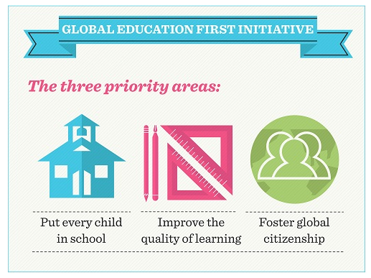
General Introduction
Beyond the ideal call for a global education, is difficult to unambiguously define GCED.
Despite its apparent semantic ambiguity and conceptual vagueness, GCED is not as vague as it might seem.
There are some recognized topics and conceptual dimensions

Slide 3
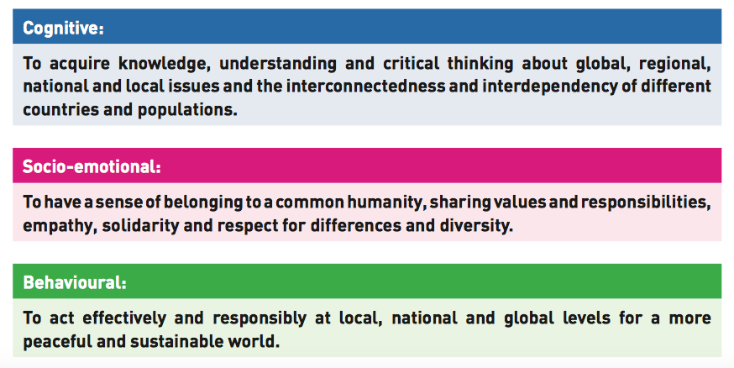
Conceptual dimensions of GCED (UNESCO, 2015)

Slide 4

17 Partners from 10 EU Countries
COUNTRY | Partners | Type
ITALY | Provincia Autonoma di Trento | Local Authority
 | Training Centre for International Cooperation | NGO
 | Regione Marche | local Authority
 | Comunità Volontari per il Mondo (CVM) | NGO
IRELAND | Trócaire | NGO
 | St Patrick's College of Education | Education
AUSTRIA | Südwind Agentur | NGO
 | Tiroler Landesregierung | local Authority
CZECH REPUBLIC | People in Need | NGO
PORTUGAL | Escola Superior de Educação do Instituto Politécnico de Viana do Castelo | Education
LATVIA | Rezekne Municipality | local Authority
UK | Cumbria Development Education Centre | NGO
FRANCE | Le Partenariat | NGO
 | Ville de Dunkerque | local Authority
BULGARIA | Expert Support Association | NGO
 | Sofia Municipality - District Serdika | local Authority
SPAIN | Diputación Provincial de Zaragoza | Local Authority

Slide 5
Global Schools: EYD 2015 to embed Global Learning in primary education
Action 1.3.1 Comparative and qualitative research on teacher training practices
Main purpose:
To analyse GCED teacher training practices in order to identify success factors, conditions for failure, promising and innovative practices and provide evidence-based policy recommendations.

Slide 6
Research Part 1:
Exploratory comparison
  Analyse existing educational policies, strategies, school curricula in 10 EU countries to ascertain whether, to what extent and how GCED is integrated in the primary school curriculum
  Then To investigate in-service teacher training practices to explore who, where and how provide teachers with the required skills, knowledge and competences to effectively embed GCE in the curriculum and teaching practice (4 case studies, Austria, Czech Republic, Ireland and Italy, expected 2017)

Slide 7
Education policy:
A coherent set of decisions or recommendations with a common middle or long-term objective (or objectives) affecting or relevant to the integration of GCED in formal primary education. As a wide-ranging process of implementation if ideas into practices, a policy encompasses also plans, programs and guidelines.
This research describes policy as political process that has an impact on the integration of GCED in formal primary education system.

Slide 8
Objectives of qualitative comparative policy analysis
Main purpose:
To analyse existing educational policies, in Europe to ascertain whether, to what extent and how GCED is integrated in formal primary education.
To identify the key documents relevant for teachers in each country
To identify key documents relevant for teachers at international/EU level
To create a glossary of relevant terms both in English and in national languages
To create a conceptual organization of the notion of GCED
To reconstruct the political discourse surrounding the implementation of GCED in 10 EU countries and at EU level
To compare the integration of GCED into formal primary education across EU countries

Slide 9
Research methodology
What?
  To what extend is GCED embedded into formal primary schools
How?
  Analysis of policy documents and interviews to key informants
  Organization in clusters to supervise and inform research execution of partners
Who?
  10 partners,
  international level (EU, international documents)
  third countries (Finland, Greece, Belgium, Germany)
Research Methods
  library research, document analysis, policy analysis, interviews with key informants

Slide 10
Data collected overall description
164 policy documents of project partners (9 countries effectively collected data)
On average 18 policy documents per project partner
Mainly national level policy documents (78%)
Regional documents role (15%)
Non-project partners policy documents analysis:
11 international policy documents
6 EU policy documents
3 third countries policy documents

Slide 11
Policy documents frequency table
 | Regional/reccomendatory | Regional/normative | Country/reccomendatory | Country/normative | International/normative | International/reccomendatory | Total
Austria | 1 | 1 | 1 | 1 |  |  | 4
Bulgaria
Czech Rep. |  | 2 | 1 | 12 |  |  | 15
France |  |  | 5 | 1 |  |  | 6
Ireland |  |  | 16 | 27 | 4 | 2 | 49
Italy | 7 | 4 | 7 | 4 |  |  | 22
Latvia |  |  | 3 | 3 |  |  | 6
Spain |  | 10 |  | 3 |  |  | 13
Portugal |  |  | 11 | 8 |  | 5 | 24
UK |  |  | 7 | 18 |  |  | 25
EU |  |  |  |  |  | 6 | 6
Finland |  |  |  | 1 |  |  | 1
Germany | 1 |  | 1 |  |  |  | 2
International |  |  |  |  |  | 11 | 11
Total | 9 | 17 | 52 | 78 | 4 | 28 | 184

Slide 12
Elements for comparison
To what extent GCED is integrated in national curriculum
Possible indicators
  Pre-service training
  In-service training
  Financial resources
  Monitoring and assessing procedures
  Explicitly indicated in the curriculum
what is the role of national/regional government? which political bodies are involved in its promotion
what is the most widely used concept to define GCED (if not GCED itself), and related concepts
what are the historical antecedents of CGE?
GCED integration process
Use of the terms

Slide 13
Preliminary Comparative Policy Analysis
 | GCED in curriculum | State’s Role | NGO’s Role | Most used term | Related terms | Historical antecedents
Austria | no, but space for integration | 3 regions projects | key. teaching materials | intercultural education | intercultural edu. Global Edu. human/children rights | civic education
Bulgaria
Czech Rep. | yes | Ministry of Foreign Affairs | n.a. | Global Development Education (EtTEGC) | Globalization Human rights Global issues Humanitarian aid…
France | yes | nation state | national platform for D.E. | citizenship and international solidarity education | civic education international solidarity development edu. | development edu.
Ireland | no, but related concepts | Dept. Education Dept. of Foreign Affairs | promote “GCED” | development edu intercultural edu | citizenship human rights interdependence sustainability justice – inclusion | intercultural edu
Italy | no, but space for integration | Ministry of Edu Ministry of F.A. Role of APTn | promote “GCED” | intercultural edu development edu | responsible citizenship | intercutural edu development edu
Latvia | no, but related concepts | local municipality funds | national platform | global education | intercultural edu sustainability Human right edu. inclusive edu citizenship edu… | development edu
Spain | no | related concepts marginal | develop teaching methods | development edu. | citizenship edu. values edu. emotions – Human R… | development edu
Portugal | no | Ministry of Education & Sc | crucial with Ministry F.A. | development edu. |  | citizenship edu development edu.
UK | no, declining | divergences in 4 national systems | enhance and support school practice | Global learning | citizenship edu EfSDGC | citizenship edu

Slide 14
Preliminary analysis: GCED Integration Process
To what extent GCED is integrated in national curriculum
continuum
What is the role of national/regional government? which political bodies are involved in its promotion
  two bodies (Ministry of Education and Foreign Affairs)
  role of Local Authority rarely relevant (if not autonomous, like PAT)
NGOs crucial for:
  Moving forward the umbrella term GCED
  providing teaching tool, techniques, materials
  national and international networking
maximum integration
No integration

Slide 15
Preliminary discussion with stakeholders to identify thematic areas
GCED
peace
human rights
diversity issues
social and economic justice
environment

Slide 16
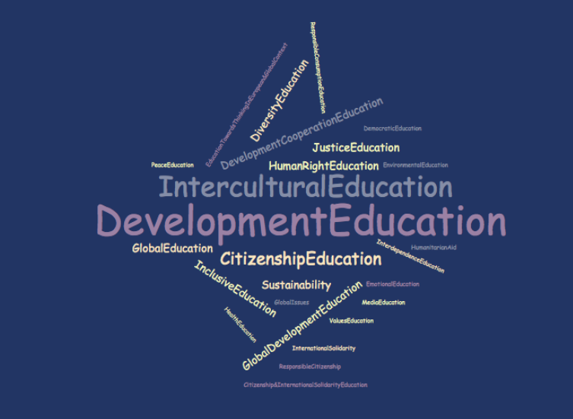
Preliminary Analysis. Use of the terms

Slide 17
Preliminary Analysis: Use of the terms
Historial antecedents
  Development education (mostly)
  intercultural education
  citizenship/civic education
In school policies, with few exeptions, still prevails “development education” and “intercultural education”

Slide 18
Word | Weighted Percentage
Development education | 25,56%
intercultural education | 16,67%
citizenship education | 10,00%
Human right education | 5,56%
Sustainability – Sustainable development | 4,44%
Global development education | 3,33%
Global education | 3,33%
Values education | 3,33%
Development cooperation education | 2,22%
Diversity education | 2,22%
Inclusive education | 2,22%
Justice education | 2,22%
Responsible consumption education | 2,22%
Democratic education | 1,11%
Education towards thinking in European and global context | 1,11%
Emotional education | 1,11%
Environmental education | 1,11%
Global issues | 1,11%
Health education | 1,11%
Humanitarian aid | 1,11%
Interdependence education | 1,11%
International solidarity | 1,11%
International solidarity education | 1,11%
Media education | 1,11%
Peace education | 1,11%
Responsible citizenship… | 1,11%

Slide 19
